Slide 1
Cryptocurrency Optimization Model
Chandler Grinnell

Slide 2
Problem and Goals
Problem Statement: Cryptocurrency dispersion is high and hard to predict.
Hypothesis: by looking at how other coins move and have moved, we can predict how they will continue to move in the future, allowing us to construct an optimal portfolio.

Slide 3
Two Common Scenarios...
NXS Price ($)
BTC Price ($)

Slide 4
Data
2000 hours of closing prices, with 84 different cryptocurrencies
Scaled Cumulative Returns*
* As of 12/5/2017, for illustrative purposes excludes coins with less than -500% return

Slide 5
Vector Auto Regression Model

Slide 6
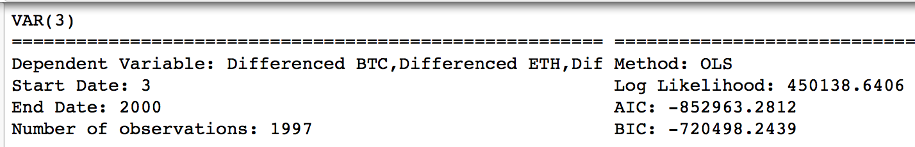
Vector Auto Regression (VAR) Model
Variables are 84 different crypto currencies, differenced, using 1, 2, 3 period lags
Model has some overfitting

Slide 7
VAR Model Moving Fit

Slide 8
VAR Model Moving Tests

Slide 9
VAR Model Predictions

Slide 10
Optimal Portfolio

Slide 11
Correlations of returns
Train Data correlations
VAR Predicted Correlations

Slide 12
Portfolio Theory
Combinations of securities, even correlated ones, will reduce overall portfolio risk (standard deviation)
Given the possible combinations of weights for the currencies, a rational investor wants the highest return for each unit of risk
Using completely random weights and returns

Slide 13
VAR Model Optimal portfolio

Slide 14
Future Improvements

Slide 15
Future Improvements
Create a less fitted model
Use other sources of date for the model (twitter, varying exchanges)
Try other types of models

Slide 16
Appendix

Slide 17
Citations
Python for Data Analysis (Wes McKinney, 2012)
Python for Finance (Yves Hilpisch, 2014)
https://datascience.stackexchange.com/questions/10459/calculation-and-visualization-of-correlation-matrix-with-pandas
https://blog.quantopian.com/markowitz-portfolio-optimization-2/

